Slide 1
Inf553 Final Demo
Movie Recommendation
Wei Shi, Zhihao Rong, Jianwen Xiao

Slide 2
Content Based Recommendation
Collaborative Filtering Recommendation
Find similar items
ALS Algorithm

Slide 3
Content Based Recommendation

Slide 4
Dataset and Library Used
import math
import numpy
import sys
import pandas:
--I used this library to merge two table, “credits.csv” and “movie_metadata.csv”, by id column
Credits table contains id, director, actors’ information.
Metadata table contains id, movie title, genres, overview and other trival columns

Slide 5
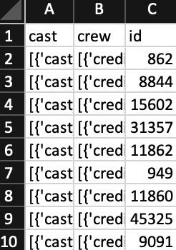
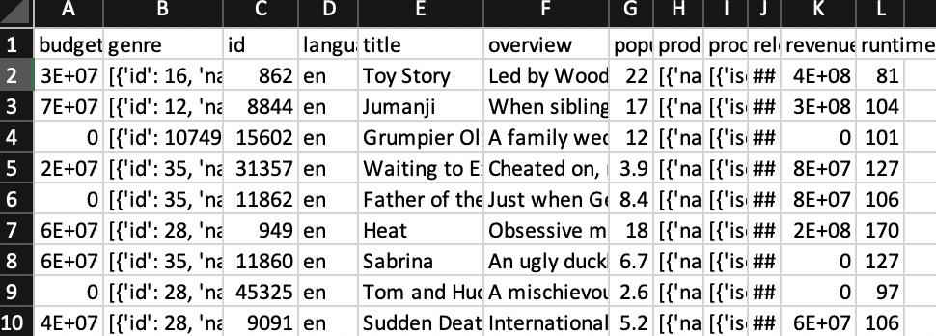
Data Processing
df1=pd.read_csv('credits.csv')
df2=pd.read_csv('movies_metadata.csv')
df1=df1[df1.id.apply(lambda x: str(x).isdigit())]
df2=df2[df2.id.apply(lambda x: str(x).isdigit())]
df1=df1.applymap(str)
df2=df2.applymap(str)
df2= df2.merge(df1,on='id')
dfActual=df2.head(dataSize)
Some rows in dataset are disordered.
I have to filter them out before merging.

Slide 6
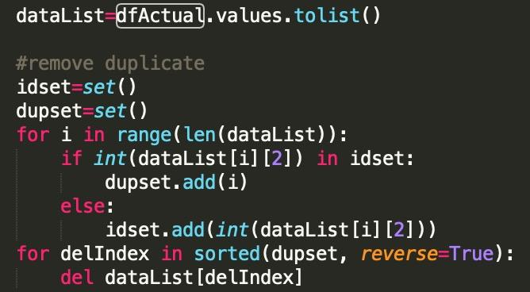
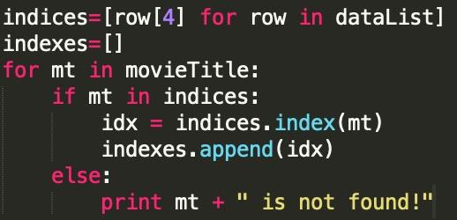
Remove Duplicate and Locate Favorite Movies

Slide 7
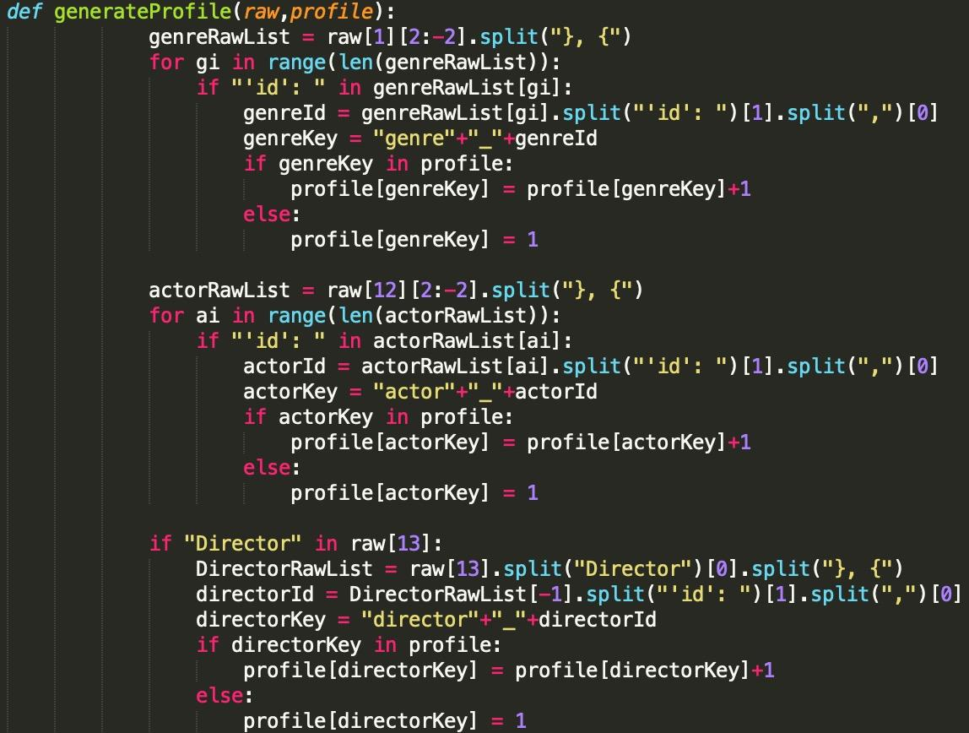
Generate Profiles(1)
Generate User Profile based on user’s favorite movies
Use Dictionary:
Key: could be “actor_actorId” “director_director_Id”
“genre_genreId” appeared in favorite rows
Value: Count of occurence within favorite movies divided by count of favorite movies
Generate item(movie) profile within the dataset rows you want to scan
Value should always be 1

Slide 8
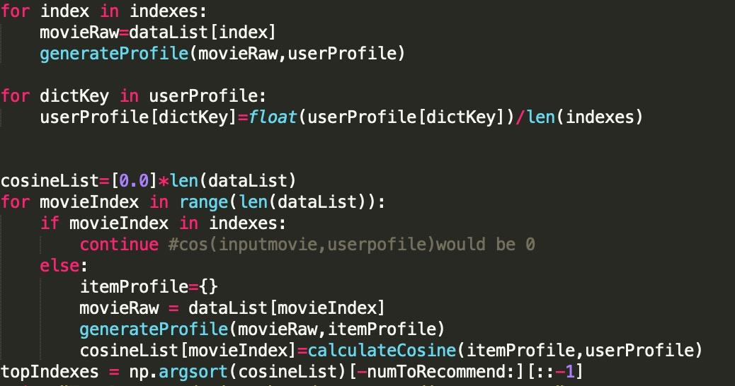
Generate Profiles(2)
May use spark to calculate profile in parallel, though it is not that slow to implement it in loop
Calculate Cosine Similarity List and get indexes corresponding to max N(#you want to recommend) values

Slide 9
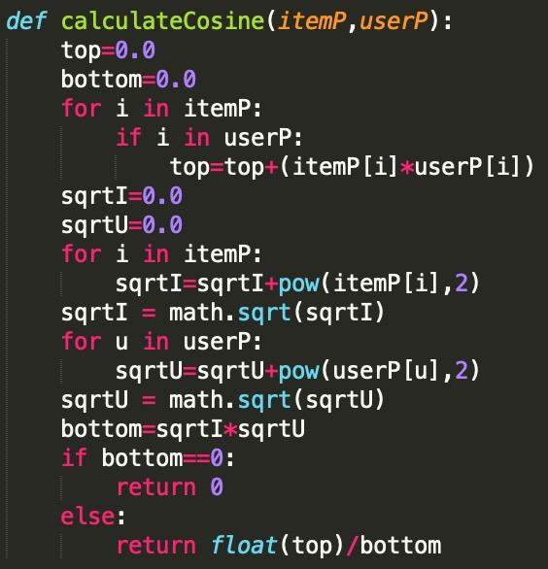
Measured by Cosine Similarity between Profile dictionaries

Slide 10
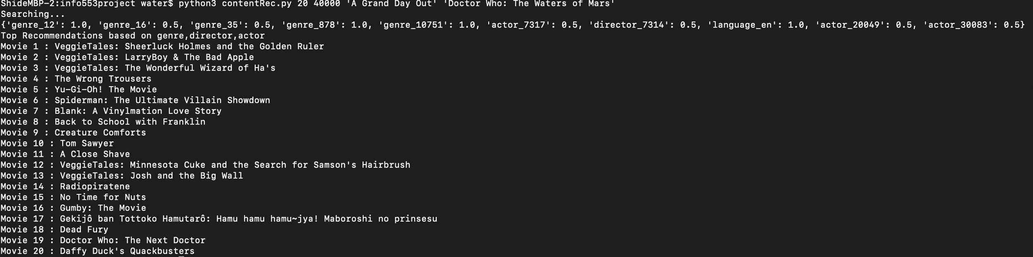
Sample output
Python3 contentRec.py #[recommendation] #[data size you want to scan] [movie titles separated by space]

Slide 11
Collaborative Filtering
Recommendation
(Find similar items)

Slide 12
Dataset: rating_medium.csv
20291 movies
10183 users
1 million ratings

Slide 13
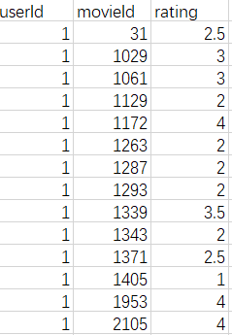
Only keep positive ratings
(>=3)

Slide 14
Find similar what?
Recommend movies to a particular user.
Find similar user (User as a set)
Input: User ID
Output: top movies that similar users have watched (at most 5)
Recommend movies based on a movie the user is watching.
Find similar movie (Movie as a set)
Input: Movie ID
Output: top movies related to the input movie (at most 10)

Slide 15
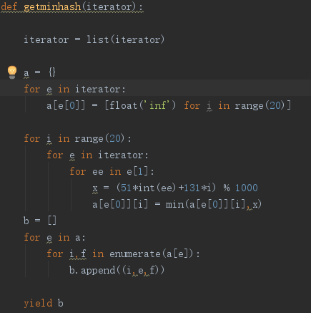
Challenges and algorithms
Large sets:
Some users have watched many movies and some popular movies have been watched by many users.
Solved by calculating minhash signature of each set.
Need to adjust minhash functions to fit the problem.
Done by spark parallely

Slide 16
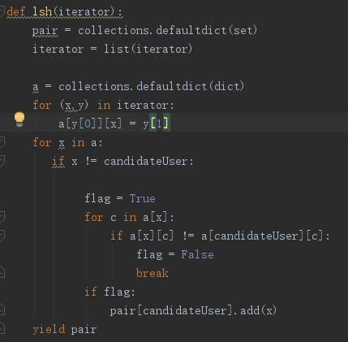
Challenges and algorithms (Cont’d)
Large numbers of sets:
20291 movies and 10183 users
Solved by locality-sensitive hashing
Need to adjust bands and rows to fit the problem
Done by spark parallely

Slide 17
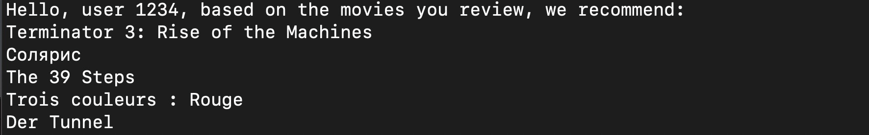
Output demo
Based on similar user

Slide 18
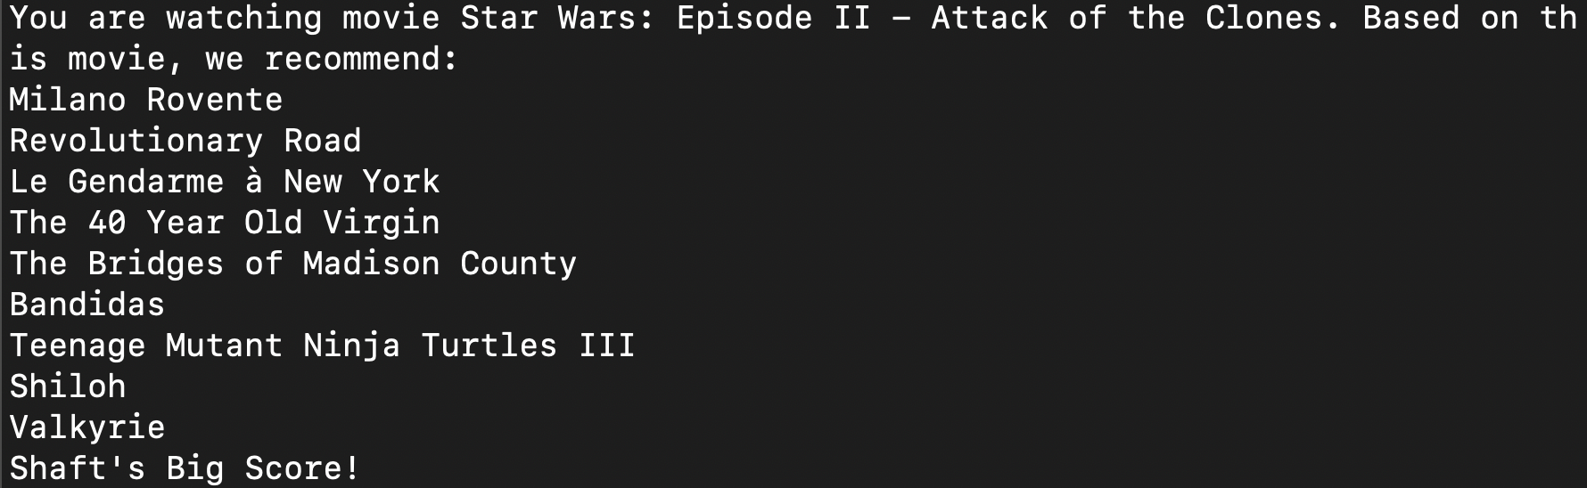
Output demo
Based on similar movie

Slide 19
Collaborative Filtering
Recommendation
(ALS Algorithm)

Slide 20
Dataset: rating_medium.csv
20291 movies
10183 users
1 million ratings

Slide 21
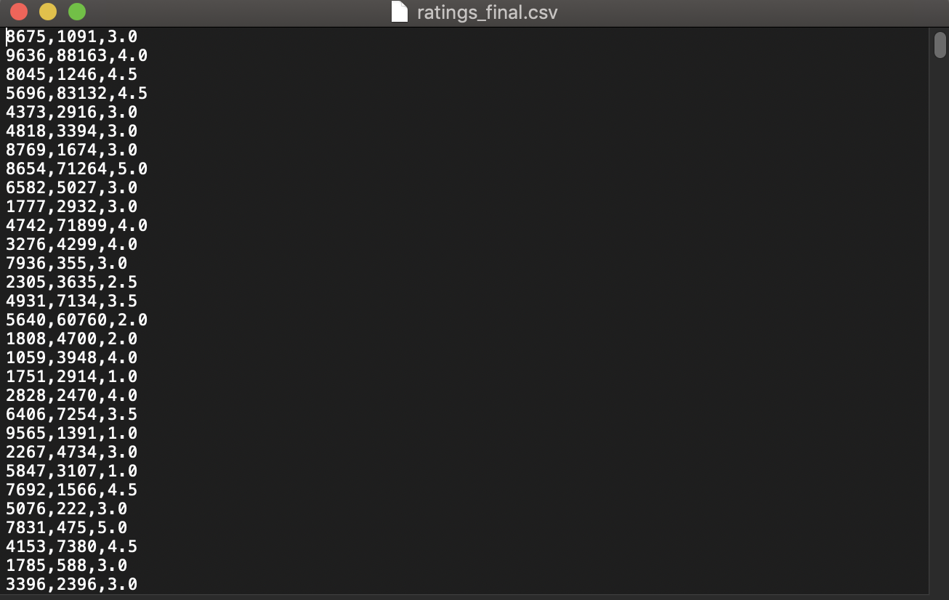

Slide 22
ALS Algorithm
UV-decomposition
Rating Matrix
(U M)
User Factor
Matrix
(U F)
Movie Factor Matrix
(F M)

Slide 23
ALS Algorithm
Broadcast
UV-decomposition
One column of Movie Factor Matrix
User Factor
Matrix
(U F)
One column of Rating Matrix

Slide 24


Least Squares Method
Minimize error
Solution

Slide 25
Alternating
Broadcast
Take transpose
One row of User Factor Matrix
Movie Factor
Matrix
(M F)
One row of Rating Matrix

Slide 26
Prediction & Recommendation
For movie recommendation given particular user, construct new Rating Matrix multiplied by User Factor Matrix and Movie Factor Matrix, select movies with top 10 highest score for the user.
For movie recommendation given particular movie, compare movie vector with Movie Factor Matrix, output top 10 movies closest to movie.

Slide 27
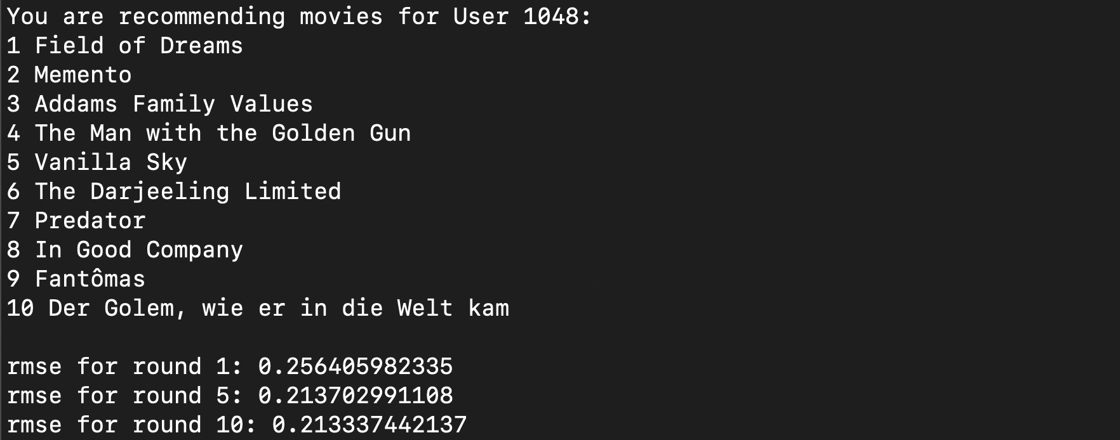
Output demo
Recommendation given user(10 latent factors, 10 iterations)

Slide 28
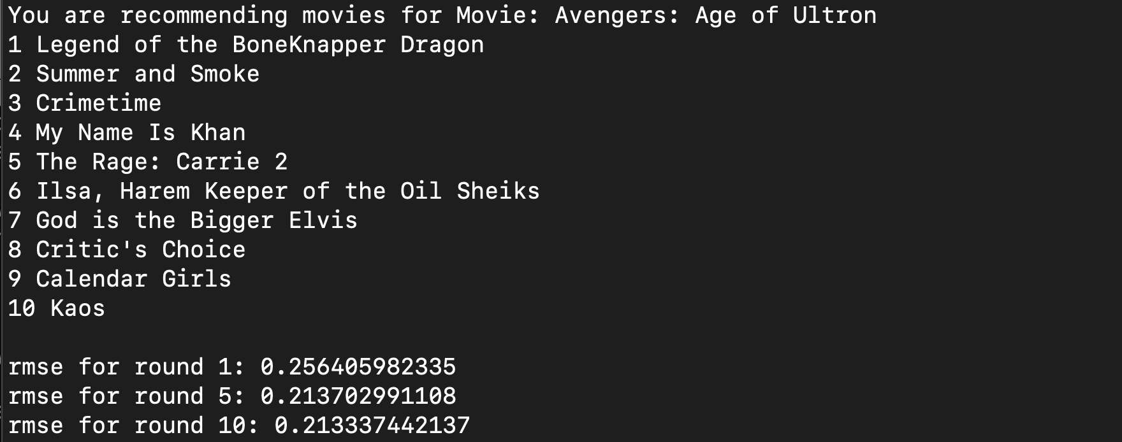
Output demo
Recommendation given movie(10 latent factors, 10 iterations)

